Slide 1
Powerful Partnership
Robinson Oil Corporation

Slide 2
Events that Impact Your Bottom Line
Labor costs of driver taking time to fuel
Lost productivity
Accounting costs of tracking data & processing invoices
Abuse of fuel cards usage
Hidden costs of national fleet fuel programs
We’ll help you LOWER your cost of fueling
Keeping your business moving, one tank at a time.

Slide 3
Driver Identification (DID/Pin number)verification
Restrict Products *
Limit number of gallons per fueling
Limit number of daily transactions
E-receipts (real time)
Restrict time of day and day of week card can be used
Limit number of gallons per day/week/month by card
Restrict sites/states card can access
Email notification when attempts are made outside of the profile YOU create
*Not all sites have product restriction
SECURITY CONTROLS
YOU are in control:

Slide 4
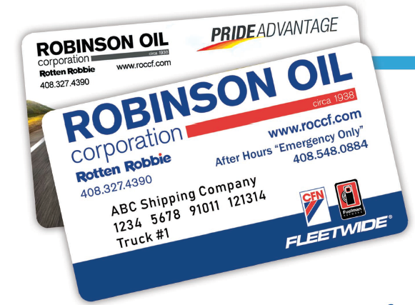
Single Card
Best serves small fleets whose employees drive the same unit
each day. The card could be assigned to the employee or to the
vehicle.
Floating Driver I.D.
Better for larger fleets, or for fleets whose employees change
units regularly. The card is assigned to the vehicle and each
employee gets a personal Driver ID (DID). This allows your drivers to rotate vehicles, while still tracking vehicle consumption & see which driver fueled each unit.
Fleet Card Options

Slide 5
Card summary
Vehicle summary
Separate by department/location
MPG & CPM calculation
Tax summary
Available electronically
Customized reports downloadable to your fleet management software
Customized invoicing per your specifications
NO FEES
Detailed Invoicing

Slide 6
Who is Robinson Oil Corporation?
Doing business for over 80 years
Member of CFN Fleetwide and Pacific Pride (allowing total flexibility at Cardlock sites & Retail locations)
Owns and operates 36 fueling locations under flagship brand “Rotten Robbie”
Personalized Customer Service
Technology supporting online account management and Electronic Data Transfer per your specifications

Slide 7
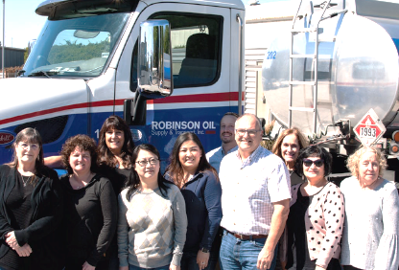
Who is Robinson Oil Corporation?
A company dedicated to providing outstanding customer service - we treat all our customers with respect
A company that has invested in the latest technology to provide the most flexible Fleet Fueling accounting program available
A company committed to ongoing growth & improvement
A company that hires proven industry leaders - we value our employees
A company who understands that growth comes by providing maximum value to its customers

Slide 8
Powerful Partnership
Reduce fuel costs: Save time and money
Online fleet fuel account management
Electronic data transfer
Designated account specialists
Flexible security controls…YOU DECIDE

