Slide 1
Post-Dynamex Developments and the New Prime Decision
Paul Marron, Esq.
CDA Courier Legal Labor Law Webinar, February 6, 2019

Slide 2
CONFIDENTIALITY
This presentation is only for members of CDA and includes advice and discussion focused on the legal interests of the CDA industry.
It is to be used only by members of the CDA community.
Those who do not fit the above criterion and by intention or inadvertence receive a copy of this power point and/or audio recording are not authorized to review, use or disseminate it.
2

Slide 3
Goals Today
Review the Dynamex Decision.
Review Developments Post-Dynamex.
Discuss the recent U.S. Supreme Court decisions on Arbitration including the New Prime Decision.
Discuss Adaptations and Considerations for Your Business Models to Lessen Your Misclassification Risks.

Slide 4
Let’s Review: the Dynamex ABC Test
In April of 2018, the California Supreme Court ushered in a new era for analyzing employee status and adopted the ABC Test for wage order claims.
The ABC Test partially supplants the old Borello multifactor Test.
The ABC Test applies only to Wage Order Claims.
Notes:
wage orders address limited issues. As noted in the bullet above, because the wage orders address only a limited number of issues, a Borello analysis remains for most other purposes, including workers’ compensation and state taxes. However, businesses should expect that there will be attempts to expand the definition of an employee using the ABC test to cover other aspects of the Labor Code and state taxes. While the court’s own opinion appears to reject such expansion, that will not stop attempts to do so.

Slide 5
Out with the Old?
The Borello Factors
Control factor
Whether the principal had a right to control the manner and means by which the contractor accomplished work.
Retained control: Evidence of the right to exert control. e.g. Strong evidence for control exists where there is a right to discharge at will whether exercised or not.
Actual control: Operational controls exerted by managers but not contained in contracts, handbooks, manuals, etc.
Secondary factors
Distinct occupation or business;
Supervision;
Skill;
Supplies the instrumentalities and tools;
Duration of services (long durations are indicia of employment);
Payment: whether by the time or by the job;
Part of the regular business of the principal; and
What the parties believe: Independent contractor vs. employee.
Notes:
NOT QUITE. What did Dynamex Actually Replace?
It is helpful to do a quick review because it shows how many of the concepts being shared today were also recommended even under the Borello Standard.
IT IS ALSO IMPORTANT TO NOTE THAT BORELLO REMAINS THE STANDARD FOR NON-WAGE ORDER RELATED CLAIMS: e.g., claims for reimbursement, workers compensation claims,, wrongful termination in violation of public policy, waiting time penalties and UCL claims.

Slide 6
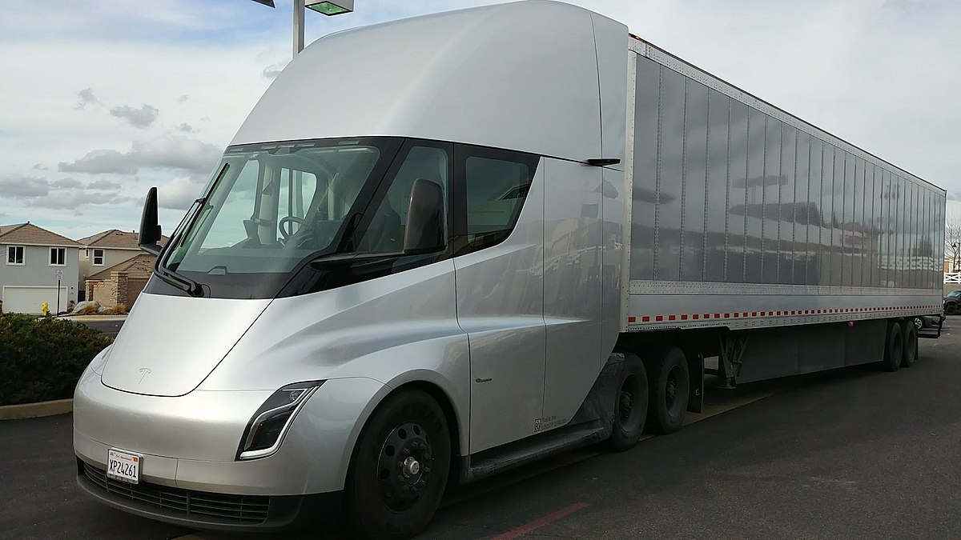
In with the New!
The ABC Test presumes all hired workers are employees unless hiring entity can prove that the worker:
Is free from control and direction from the hiring entity;
Performs work that is outside the usual course of the hiring entity’s business; and
Engaged in an independently established trade, occupation or business doing the same type of work as performed for the hiring entity.
ALL THREE MUST BE SATISFIED
Notes:
Multiple tests now apply, which may not be practical for many businesses.
Dynamex argued to the California Supreme Court that having two separate tests – one for the wage orders and one for other aspects of the Labor Code (not to mention for other purposes, such as state taxes) – would create confusion and be unworkable in practice.
The court rejected this argument, stating that the wage order “purposefully adopts its own definition” of who is an employee “to govern application of the wage order’s obligations that is intentionally broader than the standard of employment that would otherwise apply.”
The court went on to state that “any potential inconsistency” arises from the wage order’s broad definition, and that “it is possible under Borello that a worker may properly be considered any employee with reference to one statute but not another.”
Thus, while not explicit, the court appeared to endorse the Borello standard for various aspects of the Labor Code, including for worker’s compensation purposes, even as it adopted the broader ABC test for the wage orders.

Slide 7
What Dynamex Does Not Do:
The ABC Test applies only to Wage Orders
The ABC Test does not (currently) apply to labor code claims for:
Unreimbursed Business Expenses (e.g., fuel, insurance, maintenance, etc.);
Unlawful deductions (e.g., Occ Acc insurance);
Uncompensated meal and rest breaks.
There are competing bills in the legislature to make Dynamex the standard for all labor claims and to overturn the decision.
7
Notes:
Assemblywoman Lorena Gonzalez Fletcher (D-San Diego) announced that she would be introducing legislation sponsored by the California Labor Federation to codify the Dynamex decision. She wasted little time in introducing Assembly Bill 5. The bill is a placeholder (or “spot”) bill for now, but declares that it is intended to codify Dynamex and “clarify the decision’s application in state law.” Fletcher seeks to move application of the ABC Test to workers compensation and unemployment insurance claims.
Assembly Bill 71 by Assemblywoman Melissa Melendez (R-Lake Elsinore) proposes to essentially revert to life before Dynamex by declaring that, for purposes of state law, the determination of whether someone is an employee or an independent contractor shall be based on the multifactor Borello test that applied before the California Supreme Court adopted the new ABC test.

Slide 8
Part B is of highest concern:
The worker’s job is independent, separate, and distinct from the hiring entity’s business
Examples given by Dynamex Court: outside plumber or electrician hired by retail store is a distinct independent contractor
Distinct means routinely hired my multiple companies, not a single principal company
Distinct means not an integral part of principal company’s business or services
8
8
Notes:
The A Prong is nothing new. You all have heard repeatedly that business should take steps to ensure that the business does not exercise control over the driver. If a business cannot meet this standard, it likely will have failed the Borello Test.
Businesses should take care to define their business and how it relates (or better, does not relate) to the services being performed for purposes of the “B” prong. Businesses should carefully review the kinds of public statements made in marketing material and websites that describe the business and refine them as appropriate.

Slide 9
Part C Requires Indicia of Self-Employment
Incorporation, licensure, advertisements or routine offerings of service to the general public unrelated to hiring entity.
Seriously consider contracting only with drivers who have formed a business entity and that, at the least, provide services for multiple companies.
Use contract and operational terms to protect your client base and customers.
9
Notes:
Businesses should as best as possible make sure that the worker is a bona fide independent contractor, has all required licenses and other clients, and holds himself or herself out to an appropriate market as being in the business of providing such services.
While small businesses are great, ideally it is best not be someone’s first customer.
Gather appropriate documentation before the start of any engagement (business license, business card, advertising, references).
A business should consider where practical establishing contracting standards and not contracting with any business that does not meet them. These standards could include contracting only with legal entities (whether C or S corporations or limited liability companies). Using bona fide corporations may add a further argument that the workers fall entirely outside the ABC test because they are not performing services as individuals

Slide 10
Have you Adapted Your Business Model? (1)
Procedures that did not past muster in Dynamex:
Independent contractor drivers were converted from employees
Drivers provide own vehicles and pay expenses (fuel, tolls, maintenance, insurance, taxes, workers comp, Nextel device).
Drivers set own schedules but must notify Dynamex of days they are available in advance.
Drivers assigned delivery list daily. Must notify "promptly" if they reject an offered delivery and are liable for any loss incurred as a result. Drivers can set route/sequence of deliveries but must complete all deliveries same-day and must comply if a customer sets the route.

Slide 11
Have you Adapted Your Business Model? (2)
Procedures that did not past muster in Dynamex (cont’d):
Drivers wear Dynamex shirts/badges. Some Drivers required to have decals on vehicles.
Dynamex obtains the customers, sets all rates, negotiates amount paid to drivers, and retains right to control number and nature of deliveries it offers.
Drivers can hire other drivers and can drive for other companies, but cannot divert deliveries to another provider.
Dynamex retains right to terminate without cause on 3 days' notice.

Slide 12
Considerations
Technology Solutions:
Allow for pricing negotiation on at least some deliveries
Track and Record Negotiated Pricing
Develop and maintain a software system that allows you prove driver independence in court
Document and refute driver claims that:
“I had to accept all deliveries or they would block me from the system”
“I had no right to negotiate any of the rates paid”
“They penalized me for rejecting deliveries”
“They penalized me for asserting my rights”
“The dictated the delivers and routes I had to take”
“I had to work 16 to 20 hour days to break even”
Management & dispatcher testimony cannot win the “he said/she said” battle.

Slide 13
Considerations
Technology Solutions:
Algorithmic Dispatch – Remove the human factor
Deliveries & Routes Posted Electronically
Give Drivers Choice in Accepting and Rejecting Deliveries
Track those Driver Decisions;
Post Large Volume Deliveries the Afternoon Prior to Establish “Freedom of Choice”

Slide 14
Considerations
Operational Solutions:
Contract only with drivers that have formed business entities
DBA’s are insufficient
Identify local “business advisors” to whom you can refer drivers for incorporation and LLC status
LLCs can be attractive because it allows entrepreneurial drivers to grant “membership” interest to arguably allow classify the drivers they worth with as “partners” or independent contractors.
Contract only with drivers that maintain a business license
Focus on drivers that hire other drivers through their business entity
Contractors must always be able to provide services to other companies and work independent from your company.
Do not restrict or interfere with contractor advertising.
You can still maintain a strong contract with drivers that prohibits solicitation, customer theft, etc.

Slide 15
Post-Dynamex Developments
Curry v. Equilon Enterprises, 4/26/2018
Garcia v. Border Transportation, 10/22/2018
Alvarez v. XPO Logistics, 11/15/2018
Johnson v. Imperial Showgirls, 07/18/18
Henry Schein v. Archer White Sales, 01/08/2019
New Prime v. Oliveira, 01/15/2019
15
Notes:
WE ARE NOW GOING TO REVIEW THE PRIMARY DECISION POST-DYNAMEX WHICH ADD TO THE DYNAMEX DECISION OR OTHERWISE AFFECT YOUR MISCLASSIFICATION RISK BY COMPLICATING EFFORTS AT INDIVIDUAL ARBITRATION

Slide 16
Curry v. Equilon Enterprises ABC Test Not Applicable in Joint Employment Context
Equilon was the first California Appellate decision in the Post-Dynamex world.
Issue:
The case involved the issue of whether an employee of a company that leased services stations from Shell was also an employee of Shell under a joint employment theory.
Background:
Plaintiff worked as a gas station manager, managing two stations owned by Shell Oil, but operated by defendant company, ARS.
Plaintiff was hired, trained and supervised by ARS employees. ARS alone determined that plaintiff was an exempt employee.
Plaintiff alleged, in a putative class action, that she and other managers were misclassified as exempt employees and that Shell was their joint employer along with ARS.
Notes:
4th District Court of Appeals

Slide 17
Curry v. Equilon Enterprises
The trial court granted Shell’s motion for summary judgment on the ground that Shell did not exercise any control over plaintiff’s wages, hours or working conditions
Applying the “B” factor of the Dynamex ABC Test (whether the worker performed work that is outside the usual course of the hiring entity’s business), the Court held that plaintiff was NOT an employee because Shell was not in the business of operating service stations. Shell was in the business of owning fuel and real estate.
The fact that Shell may have exercised some control over the way in which ARS managed the gas stations did not create triable issues of fact on the issue of Shell controlling plaintiff
The decision provides a helpful overview of ways in which companies needing the services of independent contractors can structure their operations to avoid joint employer liability and/or to defeat the ABC factors, e.g., broker or franchise business models.
Notes:
4th District Court of Appeal.
The California Supreme Court denied review of Equilon in July of 2018

Slide 18
Garcia v. Border Transportation Group ABC Test Limited to Wage Order Claims
This case involved a independent contractor taxi-lease arrangement in the highly regulated taxicab industry in Calexico, California. Border moved for and was granted summary judgment on Garcia’s labor code and wage order claims based on the application of the Borello standard and a finding that Garcia was an independent contractor under all of his claims.
In November of 2018, the 4th District Court of Appeals reversed summary judgment on Garcia’s wage order claim based on the ABC Test first expressed in Dynamex.
The court remanded with instructions to the trial court vacate its summary judgment order and issue a new order granting summary judgment on the Non-Wage Order Claims and denying summary judgment on the Wage Order Claims.
Non-Wage Order Claim are to continue to be analyzed under the Borello standard.
A negative aspect of the decision is that in its analysis of the ABC Test for the wage order claims, the Court found that Part C of the ABC Test requires defendant to show more than a mere capability to provide services to others. They must also show that contractors in fact provide those services to others.
18
Notes:
Fourth District Court of Appeal, 28 Cal.App.5th 558, filed 10/22/18. Certified for Partial Publication as modified on denial for Rehearing 11/13/2018.
The Dynamex "suffer or permit to work" standard for determining whether a worker is properly considered an employee or an independent contractor applies to wage order claims, and the Borello standard applies to non-wage-order claims.
NOTE: THE COURT MENTIONS RETROACTIVE APPLICATION OF DYNAMEX CITING THE RULE THAT JUDGE DECISIONS ARE PRESUMPTIVELY RETROACTIVE IN DICTA, BUT DOES NOT ADDRESS THE ISSUE NOTING THAT THE DEFENDANTS HAVE ASSUMED RETROACTIVITY.

Slide 19
Alvarez v. XPO Logistics ABC Test Preempted by FAAAA
In November of 2018, the Central District of California held that Federal Aviation Administration Authorization Act (FAAAA) preempts application of the Dynamex ABC test to motor carriers for the purpose of determining whether independent contractor drivers are employees under California Wage Orders.
The Court distinguished the 9th Circuit’s decision in Dilts v. Penske Logistics which held that the FAAAA did not preempt parts of the California Labor Code explaining that Dilts addressed whether the FAAAA preempted parts of the California Labor Code itself and not whether a judicially created test used to interpret wage orders is preempted.
In short, it is the ABC Test that is preempted and NOT the underlying labor code of Unfair Competition claims. Thus, employee status under these claims must be analyzed under the Borello standard.
19
Notes:
HISTORY: Harris v. PAC Anchor Transportation, 59 Cal.4th 772 (2014) Addressing Claims brought under California’s Unfair Competition Law (UCL), the California Supreme Court unanimously found that FAAAA did not preempt claims under the UCL or generally applicable California labor laws that affect prices, routes or services. Cert denied February 25, 2015
See also Dilts v. Penske Logistics, 769 F.3d 637 (9th Cir. 2014), petition for cert filed January 9, 2015.
Alvarez is a decision by Central District of California Judge James Otero. Filed November 15, 2018
THE FAAAA PREEMPTS Application of the ABC Test because the ABC Test affects rates, routes and service by effectively prohibiting the use of independent contractors, whereas the Borello standard does not compel the use of employees or independent contractors.
In wins for the plaintiffs, the court also found the FAAAA does not preempt misclassification claims brought under California’s Unfair Competition Law. Perhaps more importantly, the court found the Federal Leasing Regulations preempt only the owner-operator plaintiffs’ claims for reimbursement of their truck lease payments, not the plaintiffs’ claims for reimbursement of various other business expenses (including, e.g., insurance coverage costs). The court’s conclusion in this regard is significant because other courts applying California law have found the Leasing Regulations preempt a wider range of expense reimbursement claims.
See also California Trucking Association v. Su 903 F.3d 953 (2018) where the 9th Circuit found that the FAAAA does not preempt application of the Borello standard because the Borellow standard does not compel a certain result (“e.g., consumer or workforce”) (“e.g., a certain wage, non-discrimination, a specific system of delivery, a specific person to perform the delivery”).

Slide 20
Johnson v. Imperial Showgirls Dynamex ABC Test Applies Retroactively
There was some speculation that the ABC Test would have only have future or prospective application.
The court in Johnson v. Imperial Showgirls has held otherwise.
Pointing to the absence of any restraints in the Dynamex decision, the Court concluded that the California Supreme Court intended its decision to apply retroactively and propectively:
“In light of the ‘general rule that judicial decisions are given retroactive effect’, and because it is up to the Supreme Court to declare an exception to this rule (see Barr v. ADandS Inc. (1997) 57 Cal.App.4th 1038, 1053), this court will apply Dynamex retroactively.”
Notes:
Orange County Superior Court
This is also an issue pending in the 9th Circuit in the GrubHub lititation.

Slide 21
Henry Schein v. Archer and White U.S. Supreme Court, January 8, 2019, Justice Kavanaugh
This is a Pro-Arbitration Decision by the U.S. Supreme Court. The parties’ arbitration agreement on who decides the question of arbitrability must be honored.
Where the arbitration clause delegates that decision to arbitrators, courts should have no say in the matter.
The “wholly groundless” exception is rejected – court’s are to enforce the parties agreement even if they perceive the argument in favor of arbitration is “wholly groundless.”
“Just as a court may not decide a merits question that the parties have delegated to an arbitrator, a court may not decide an arbitrability question that the parties have delegated to an arbitrator.”
The FAA contains no wholly groundless exception to arbitration and the courts are not free to engraft its own exceptions onto the statutory text.
Notes:
Justice Kavanaugh’s First Decision. Supreme Court unanimously overrules the 5th Circuit breaking a split between the circuits and providing a very positive outlook for the enforcement of arbitration proceedings.
This was a fairly brief and simple analysis and something to be expected from the now conservative leaning court.

Slide 22
Just when you thought it was safe to get into Arbitration
Notes:
The new conservative leaning Supreme Court gets textual on us.

Slide 23
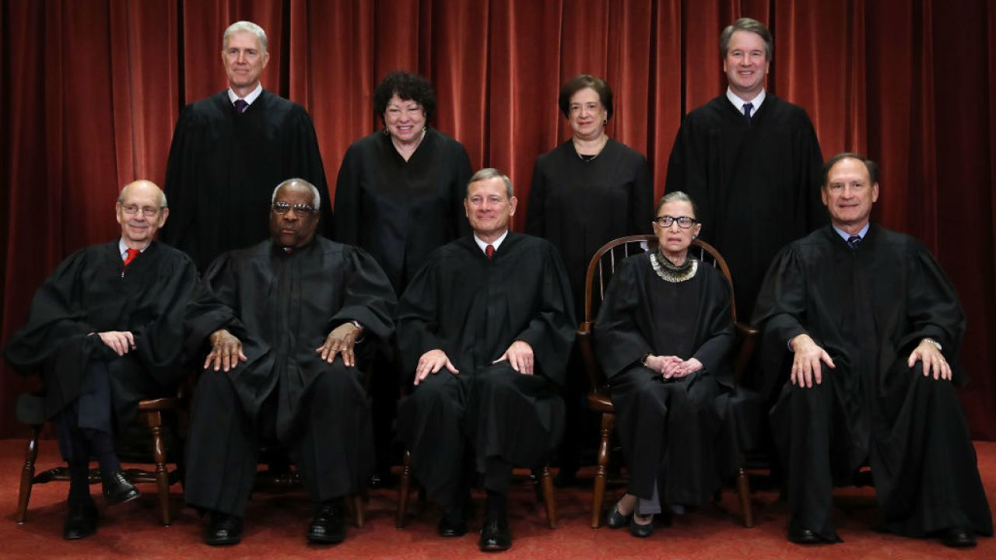
New Prime v. Oliveira U.S. Supreme Court, January 15, 2019, Justice Gorsuch
The Facts
Dominic Oliveira worked as an independent contractor for an interstate trucking company.
His agreements included a broadly worded arbitration agreement with a clause delegating to the arbitrator all issues arising from the parties’ relationship including disputes over the arbitrator’s authority.
Oliveira filed a wage and hour lawsuit against New Prime.
The Issue
Whether Oliveira could be compelled to arbitrate his claims when the Federal Arbitration Act (FAA) exempts from its application “contracts of employment of seamen, railroad employees, or any other class of workers engaged in foreign or interstate commerce.”
Notes:
Justice Gorsuch weighs in on arbitration and its not what you would think.

Slide 24
New Prime v. Oliveira U.S. Supreme Court, January 15, 2019
The Decision
Although a court should enforce the parties delegation clause that leaves questions of arbitrability to the arbitrator, courts should, however, decide in the first instance whether the FAA applies.
Courts have no authority to compel a case to arbitration if the arbitration agreement falls within the FAA’s exemption for contracts of employment for workers engaged in interstate commerce.
The Devil is in the Details
The more specific issue the Court addressed was whether independent contractors were “workers” as used in the FAA.
The Court answered this question, YES. “Workers” included independent contractors as that term was used in 1925 when the FAA was enacted
In so holding, the Court rejected modern decisions interpreting “workers” to refer only to employees and not independent contractors.
Notes:
The Court decided that Congress, in 1925, understood this term to encompass any worker, irrespective of whether there was a formal employer-employee relationship as those terms are more commonly understood today.
This is the textualists approach to statutory construction.

Slide 25
New Prime & Schein Takeaways
Individual interstate truck drivers can no longer be compelled to arbitration regardless of whether they’re employees or independent contractors.
New Prime does not address intrastate transportation workers.
New Prime involved an individual owner/operator.
Courts must make a preliminary determination that the FAA applies before any other threshold issue may be decided.
Broad delegation clauses are generally enforceable if the FAA applies.
The New Prime decision applies only to whether the FAA applies.
State arbitration laws remain applicable.
However, the FAA is preferable to the California Arbitration Act which does not permit class action waivers.

Slide 26
Where do we go from here?
Arbitration Remains a Viable Path
Intrastate Transportation: Drivers carrying cargo or goods who do not cross state lines have been generally found to be excluded from the scope of the Section 1 Exclusion to the FAA for interstate transportation workers.
Arbitration Between Business Entities. New Prime does not address whether a business entity can be a “worker” engaged in interstate commerce. Companies contracting only with business entities, particularly business entities with multiple drivers, have a very strong argument that they are not subject to the New Prime ruling.
Notes:
Dynamex means a proliferation of litigation in CA and similar/affected states.
In Circuit City Stores, Inc. v. Adams, 532 U.S. 105, 114-115 (2001), the Court limited the residual language to transportation workers engaged in foreign or interstate commerce.
The New Prime Decision does not address intrastate transportation.
The New Prime Decision does not address arbitration agreements between companies (v. individual workers).

Slide 27
Reassess Your Current Business Model
Are you holding your business out to your customers as a delivery or transportation company?
This was fatal to Dynamex. Companies that continue to hold themselves out as performing the same work as their drivers will fail the Dynamex ABC Test
Do you have both employees and independent contractors performing the same duties?

Slide 28
Reassess Your Current Business Model
Are your drivers in a different business?
Do drivers perform deliveries?
Do you procure customers, arrange for or broker the transportation, market the business?
Do driver entities pay a set fee for participation in company’s brokerage/distribution system? (Fees must be in sufficient amounts to maintain/grow company’s profits)
Revenues collected over and above fees driver entity pays to company go to driver entity
Puts company in position of providing services to driver entity, as opposed to “hiring” driver or driver entity
Incentivizes driver entity to increase productivity

Slide 29
Reassess Your Driver Contracts & Relations
Are your contracts fair and balanced? Pigs get fat, hogs get slaughtered
Do you reduce statutory time limitations?
Do you limit the damages drivers can obtain?
Do you give company rights and deny those to drivers? (Mutuality)
Do your contracts avoid employer-like controls?
Do drivers have the right to decline deliveries, set their own schedule when operating, negotiate rates?
Is your contract terminable at will or on short notice without good cause?
Does your contract call for periodic renewals v. single contract signed years ago?

Slide 30
Reassess Your Onboarding & Management Procedures
Onboarding and Managing Drivers
Do your contracts provide for a cooling off period? Do you document it?
Are uniforms absolutely required? Are drivers informed it is a customer requirement?
Are company logos required on vehicles? Perhaps identify on that labeling that the vehicle is “Independently Owned and Operated” for XYZ Corp.
Are Company Managers trained to manage contractors v. treating drivers like employees (Your managers will be your best or worst witnesses).
Are drivers provided opportunities to cure contractual violations prior to termination?
Do managers only interact with driver entity principals v. micro-managing sub-drivers?
Notes:
It is recognized that not all of these recommendations will work with all business models and customer requirements but operational changes can lower the misclassification risks.

Slide 31
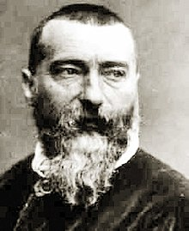
“the times, they are a-Changing” Bob Dylan, 1963 “the more things change, the more they stay the same” Jean-Baptiste Alphonse Karr, 1849
Notes:
We’re all familiar with the Bob Dylan song, The Times They Are a-Changing.
[We got a 1963 photo of Bob just so you can see he was just as beautiful then]
Long before that, however, it was said "plus ça change, plus c'est la même chose" translated commonly to “the more things change, the more they stay the same”
This is not to say you should sit back and do nothing, but many of the items expressed here today following the similar thing you have been hearing. Now is the time to act.

Slide 32
Adapting to New Prime
Emphasize the intrastate nature of the services being provided.
New Prime Applies only to interstate transportation workers only
If your operations involve interstate transportation, it is worthwhile to consider changes
Segregate interstate operations into a separate entity
Consider operational changes
Retain only drivers that operate formal business entities
Favor business entities that operate with multiple drivers
Adapt your marketing materials to reflect the intrastate nature of your operations
Adapt your contracts to reflect the intrastate nature of your operations
Adopt those changes recommended prior to and Post-Dynamex to the maximum extent possible

Slide 33
Arbitration and Class Action Waivers Post-New Prime
An effective arbitration clause that includes a class action waiver remains the single most important step a company can take to protect itself
A plaintiff lawyer’s desire to sue goes down dramatically when faced with a credible arbitration clause and class action waiver
There may be a temporary belief that New Prime is a silver bullet against arbitration, but there are steps you can take to protect against it
Arbitration is not cheap, but it drastically reduces the extortion of class action suits and runaway jury verdicts
As you can see, arbitration law is changing constantly and clauses must be prepared and monitored by deeply experienced practitioners and updated at least on an annual basis

Slide 34
Third Party Providers (TPP)
Consider an expanded role for third party providers for:
TPPs can recruit, hire and/or contract with pools of drivers/driver entities
TPPs provide services for multiple logistic companies
Your company steps out of the driver hiring and contract role and instead retains the services of a TPP who has a pool of qualified drivers who will follow your contractual terms with your customer base
Your company continues marketing, customer service, relations and retention functions, dispatch and delivery orders, while TPP handles administrative function associated with driver payments which are often the source of “employee status” determinations (settlement, insurance, occ acc, etc.)
TPPs should have a technology database with the essential capability of identifying and recording/proving that a driver/driver entity has driven for multiple companies, not just yours
Notes:
These TPPs often fit the role of providing back-office business services to drivers/driver entities

Slide 35
Outside the Box
Retain only the services of a Master Contractor and let them manage drivers (small to large companies)
FedEx adopted the Master Contractor Model
FedEx was plagued by lawsuits until it established the program
Small business entities can contract with FedEx to be a master contractor and operate up to 5 delivery vehicles
FedEx has significantly reduced lawsuits as a result
Franchise Model (medium to large Companies)
Cooperative Model (small to large companies)
Notes:
IS IT TIME FOR DRASTIC CHANGE? HERE ARE SOME IDEAS THAT BEAR REPEATING (FOR THOSE OF YOU WHO HAVE ATTENDED OUR OTHER SEMINARS AND TALKS).

Slide 36
Alternative Non-Employee Business Models
Franchise Model
“Franchising is Different” (Patterson v. Domino’s Pizza)
Allows control of business sources, quality standards, marketing and branding but service providers are recognized by law as distinct and separate business
Franchisor set ups allow revenue splits
Co-Op Model
Delivery businesses owned by drivers
Management and broker companies control marketing, source business and provide work
* Both of these models are “tried to verdict and won” tests in analogous transportation industries
Notes:
MORE DETAIL ON MAJOR SHIFTS IN BUSINESS MODELS THAT HAVE BEEN SUCCESSFUL IN THE TAXI AND SHUTTLE INDUSTRY

Slide 37
Questions ?
www.marronlawyers.com
10 attorney misclassification team. Nationwide experience and wins on misclassification
Cases handled in CA, AZ, CO, TX, OR, MO, MI, FL, AL, TN, MN, NY, and HI
Contact Paul Marron:
pmarron@marronlawyers.com
(562) 432-7422

